Slide 1
Functional Dependency
Closure
Minimal Cover on FD
Equivalence of FD

Slide 2
Closure
There are three steps to calculate closure of functional dependency (A->B). These are:
Step-1 : Add the attributes which are present on Left Hand Side in the original functional dependency.
Step-2 : Now, add the attributes present on the Right Hand Side of the functional dependency.
Step-3 : With the help of attributes present on Right Hand Side, check the other attributes that can be derived from the other given functional dependencies. Repeat this process until all the possible attributes which can be derived are added in the closure.

Slide 3
Closure
1.A→B
2.B→C
3.BC→D
A+= A (step 1)
AB (step 2)
ABC (step 3)
ABCD

Slide 4
Closure
R={A,B,C,D,E}
FD={ A->BC, B->D, CD->E, E->A}
A+ = A
ABC
ABCD
ABCDE

Slide 5
Closure
R={A,B,C,D,E}
FD={ A->BC, B->D, CD->E, E->A}
B+ = B
DB

Slide 6
Closure
R={A,B,C,D,E}
FD={ A->BC, B->D, CD->E, E->A}
CD+= CD (step 1)
CDE (step 2)
CDEA (step 3)
CDEAB (step 3)

Slide 7
Closure
If R= A,B,C,D then compute closure of B for the following FD.
A->C
B->D
D->A
Solution: Let X=B
=BD
=BDA then B ⁺ = BDAC

Slide 8
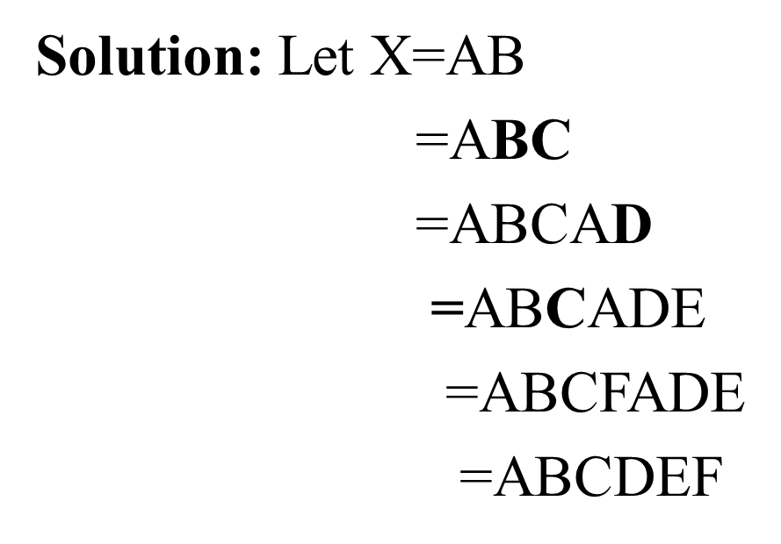
Closure
If R= A,B,C,D ,E,F then compute closure of AB for the following FD.
AB->C
BC->AD
D->E
C->F

Slide 9
Problem
A relation R(A,B,C,D,E,H) has the following functional dependencies
F= {{A→BC},{CD→E},{E→C}, {D→AEH}, {ABH→BD}, {DH→BC}}. Find the keys.

Slide 10
Solution
If K is a key of R, then K functionally determines all attributes in R.
(A)+={A,B,C}
(B)+={B}
(C)+={C}
(D)+={D,A,E,H,B,C}
(E)+={E,C}
(H)+={H}
AH+ = ABCHDE
The keys for relation R is D and AH+.

Slide 11
Minimal cover on Functional Dependency
Step-1: In RHS , should have single attribute
Step-2: In LHS, remove extraneous attributes
Step-3: Eliminate the redundancy in FD, if so.

Slide 12
Minimal cover on Functional Dependency- Problems
R={ A,B,C,D,E,F}
FD={ AB->D, B->C, AE->B, A->D, D->EF}
Step-1:
AB->D
B->C
AE->B
A->D
D->E
D->F

Slide 13
Minimal cover on Functional Dependency- Problems
R={ A,B,C,D,E,F}
FD={ AB->D, B->C, AE->B, A->D, D->EF}
Step-2:
AB->D==========➔ A+, B+
A+={A,D,E,F,B,C}
B+={B,C}
remove B in the above FD
i.e., A->D

Slide 14
Minimal cover on Functional Dependency- Problems
R={ A,B,C,D,E,F}
FD={ AB->D, B->C, AE->B, A->D, D->EF}
Step-2:
AE->B==========➔ A+, E+
A+={A,D,E,F,B,C}
E+={E}
remove E in the above FD
i.e., A->B

Slide 15
Minimal cover on Functional Dependency- Problems
R={ A,B,C,D,E,F}
FD={ AB->D, B->C, AE->B, A->D, D->EF}
Step-2:
A->D
B->C
A->B
A->D
D->E
D->F

Slide 16
Minimal cover on Functional Dependency- Problems
R={ A,B,C,D,E,F}
FD={ AB->D, B->C, AE->B, A->D, D->EF}
Step-3:
A->D
B->C
A->B
D->E
D->F

Slide 17
Minimal cover on Functional Dependency- Problems
R={ A,B,C,D,E,F}
FD={ AB->D, B->C, AE->B, A->D, D->EF}
Step-3:
A->D
B->C
A->B
D->E
D->F
Find A+ from the above FD except A->D

Slide 18
Minimal cover on Functional Dependency- Problems
R={ A,B,C,D,E,F}
FD={ AB->D, B->C, AE->B, A->D, D->EF}
Step-3:
A->D
B->C
A->B
D->E
D->F
Find B+ from the above FD except B->C

Slide 19
Minimal cover on Functional Dependency- Problems
R={ A,B,C,D,E,F}
FD={ AB->D, B->C, AE->B, A->D, D->EF}
Step-3:
A->D
B->C
A->B
D->E
D->F
Find A+ from the above FD except A->B
……

Slide 20
Minimal cover on Functional Dependency- Problems
2) R={ A,B,C,D}
FD={ A->BC, B->C, A->B, AB->C, AC->D}

Slide 21
Minimal cover on Functional Dependency- Problems
3) R={ A,B,C,D,E}
FD={ A->D, BC->AD, C->B, E->A, E->D}
Step-1:
A->D
BC->A
BC->D
C->B
E->A
E->D

Slide 22
Minimal cover on Functional Dependency- Problems
3) R={ A,B,C,D,E}
FD={ A->D, BC->AD, C->B, E->A, E->D}
Step-2:
BC->A============➔ B+, C+
BC->D============➔ B+, C+

Slide 23
Minimal cover on Functional Dependency- Problems
3) R={ A,B,C,D,E}
FD={ A->D, BC->AD, C->B, E->A, E->D}
Step-2:
BC->A============➔ B+, C+
B+={B}
C+={C,B,A,D}
So C->A

Slide 24
Minimal cover on Functional Dependency- Problems
3) R={ A,B,C,D,E}
FD={ A->D, BC->AD, C->B, E->A, E->D}
Step-2:
BC->A============➔ B+, C+
B+={B}
C+={C,B,A,D}
So C->A
Similarly ,
BC->D============➔ B+, C+
So C->D

Slide 25
Minimal cover on Functional Dependency- Problems
3) R={ A,B,C,D,E}
FD={ A->D, BC->AD, C->B, E->A, E->D}
Step-3:
A->D
C->A
C->D
C->B
E->A
E->D

Slide 26
Minimal cover on Functional Dependency- Problems
3) R={ A,B,C,D,E}
FD={ A->D, BC->AD, C->B, E->A, E->D}
Step-3:
A->D
C->A
C->D
C->B
E->A
E->D

Slide 27
Minimal cover on Functional Dependency- Problems
4) F={BC->ADEF,F->DE}

Slide 28
Equivalence of Functional Dependencies
F and G are two functional dependencies then
G is a subset of F+ i.e. F covers G
F is a subset of G+ i.e. G covers F
i.e. F+ = G+

Slide 29
Equivalence of Functional Dependencies
1) R = { A, B, C}
F={ A->B, B->C, C->A}
G={ C->B, B->A, A->C}
Check F and G are equivalent

Slide 30
Equivalence of Functional Dependencies
1) R = { A, B, C}
F={ A->B, B->C, C->A}
G={ C->B, B->A, A->C}
Check F and G are equivalent
If F covers G:
Take C->B in G
CF+ = { C, A, B }
BF+ = {B, C, A }
AF+ = { A, B, C }

Slide 31
Equivalence of Functional Dependencies
1) R = { A, B, C}
F={ A->B, B->C, C->A}
G={ C->B, B->A, A->C}
Check F and G are equivalent
If G covers F:
Take A->B in F
AG+ = { }
BG+ = { }
CG+ = { }

Slide 32
Equivalence of Functional Dependencies
F={B->CD,AD->E,B->A}
G={B->CDE,B->ABC,AD->E}

